Slide 1
MeanPug Designer Test
Nicholos Palmer

Slide 2
INTRODUCTION
Further on are the solutions to the Landing Page Project. Using Figma, I created a new logo, presented a couple of options for the client, and designed a small landing page with responsive mockup. Here are links to access the project:
Nicholos Palmer - Designer Test – Figma Pages - Logo and options - Landing Page - Wireframe and Mockup - Finished Landing Page Design OR
Figma Slide Presentation

Slide 3
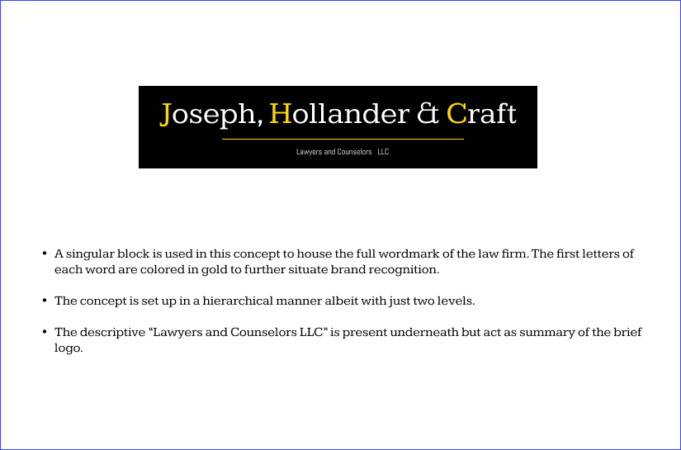
Client Feedback: New Logo
Below on figure 1, this new logo is used in the final mockups. This concept uses black - gold palette. The font: Kameron font family.

Slide 4

MAIN Logo

Slide 5
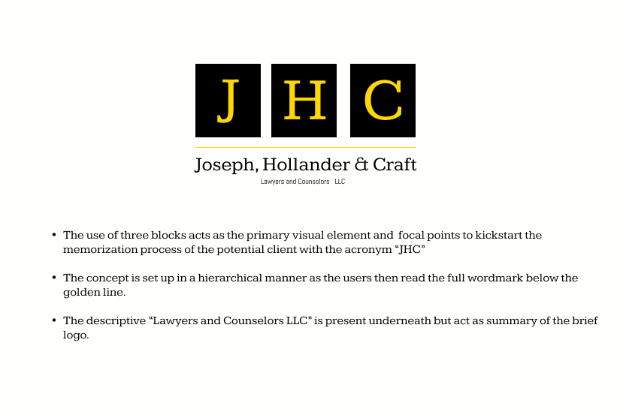
OPTIONS FOR CONSIDERATION

Slide 6
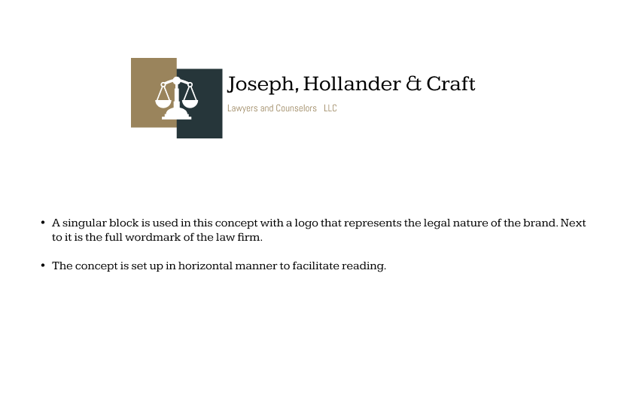
OPTIONS FOR CONSIDERATION

Slide 7
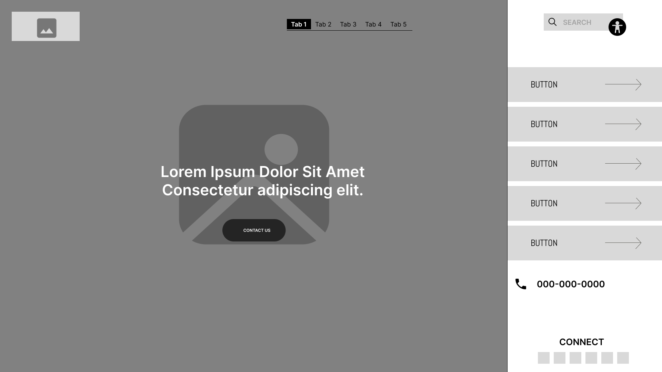
Landing Page Design: Desktop Wireframe and Mockup

Slide 8
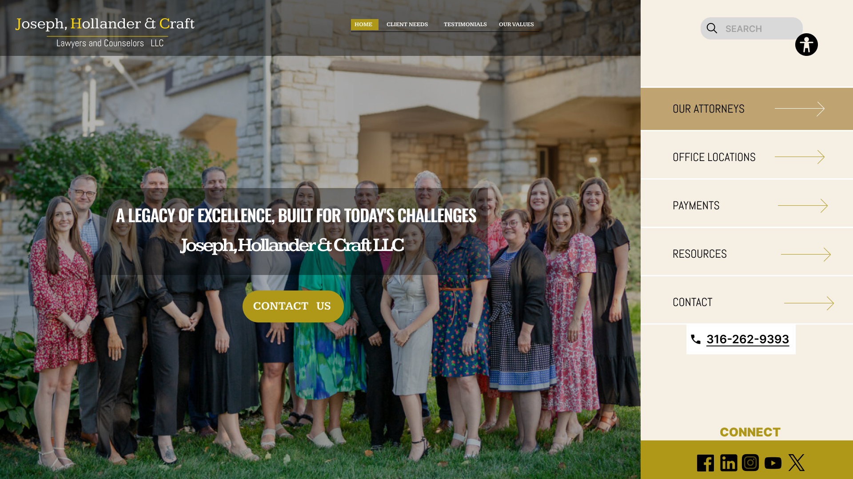
Landing Page Design: Desktop Wireframe and Mockup

Slide 9
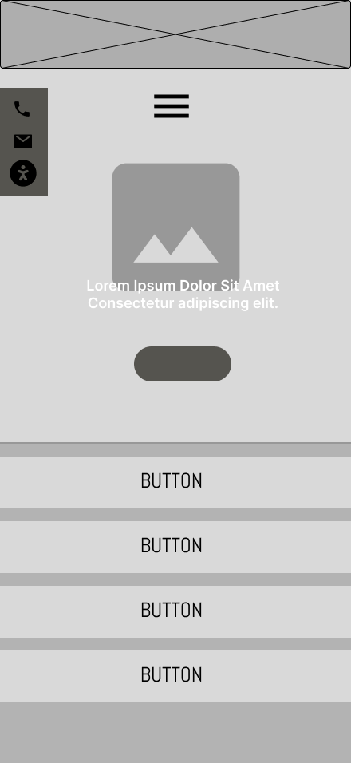
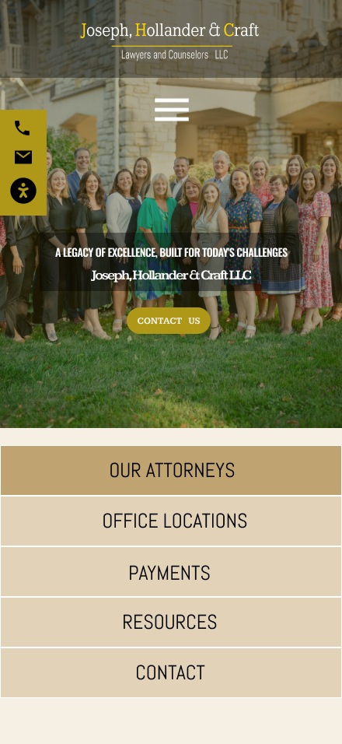
Landing Page Design: Mobile Wireframe and Mockup

Slide 10

Landing Page: Desktop & MOBILE

Slide 11
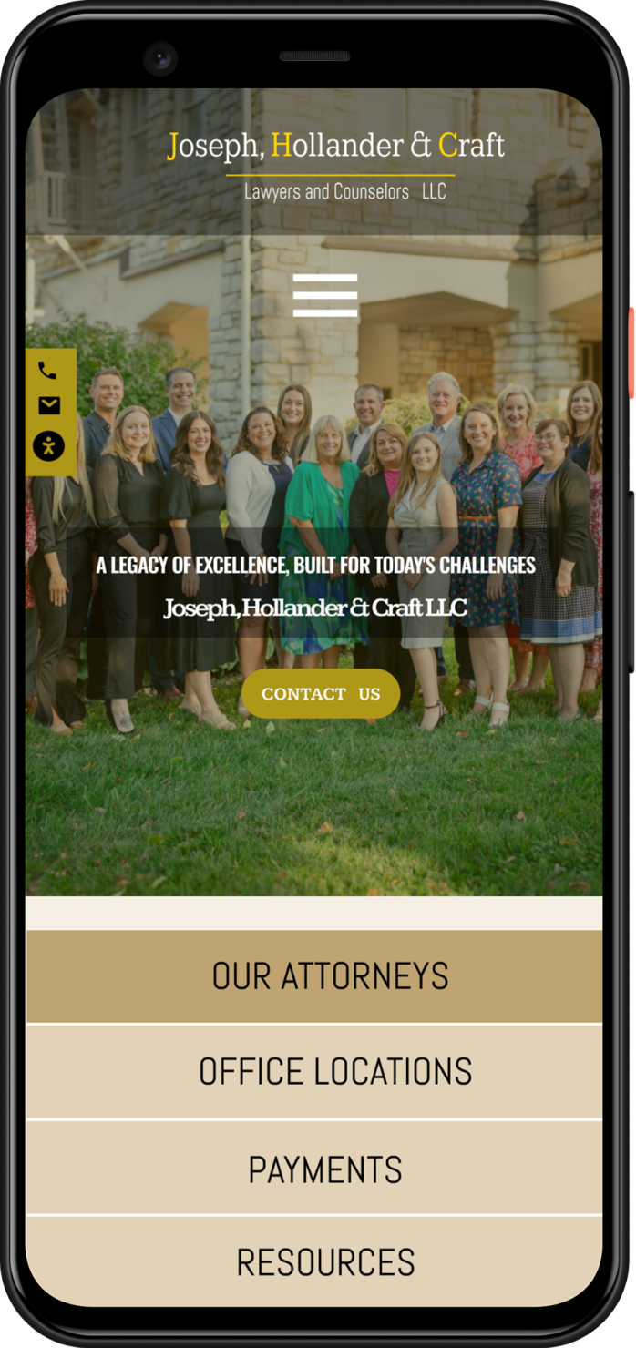
Landing Page: MOBILE & Desktop

